Slide 1

G2H Solutions
Ground 2 High - Lead Generation That Feels Human
We help B2B teams build predictable pipelines through thoughtful, targeted outreach that puts qualified buyers in real conversations with your sales team.

Slide 2

The Challenge We Solve
Inconsistent Pipeline
Random Outreach
Misaligned Teams
Your top-of-funnel feels quiet or unpredictable, making revenue planning difficult.
Mass blasts and generic templates damage your brand and waste time.
Sales and marketing lack a shared view of what success looks like.

Slide 3

What We Deliver
Qualified Meetings
Repeatable Engine
Aligned Strategy
Not just leads, actual conversations with buyers who match your ideal customer profile.
Transform sporadic outreach into a steady rhythm that supports your revenue goals.
Sales and marketing working from the same playbook with clear success metrics.

Slide 4




Our Core Services
ICP & Account Targeting
Outbound Campaigns
We clarify who you should really be speaking to through workshops, account lists, and market segmentation tailored to your sales motion.
Email and LinkedIn outreach that feels like real introductions, with personalization and structured sequences guiding prospects to meetings.
Meeting Generation
Data & Reporting
Qualified buyers booked straight to your calendar with context, notes, and clear handover rules for easy follow-up.
Clean lists, performance snapshots by segment and channel, plus practical recommendations for continuous improvement.

Slide 5





How We Work With You
Listen First
Learn how you sell, who you close, and where deals slow down.
Define Success
Agree on what a "good" lead and outcome look like.
Build a Plan
Map target segments, outreach angles, and timing.
Launch & Learn
Get into market, listen to responses, adjust quickly.
Scale What Works
Lean into segments and messages that move the needle.

Slide 6
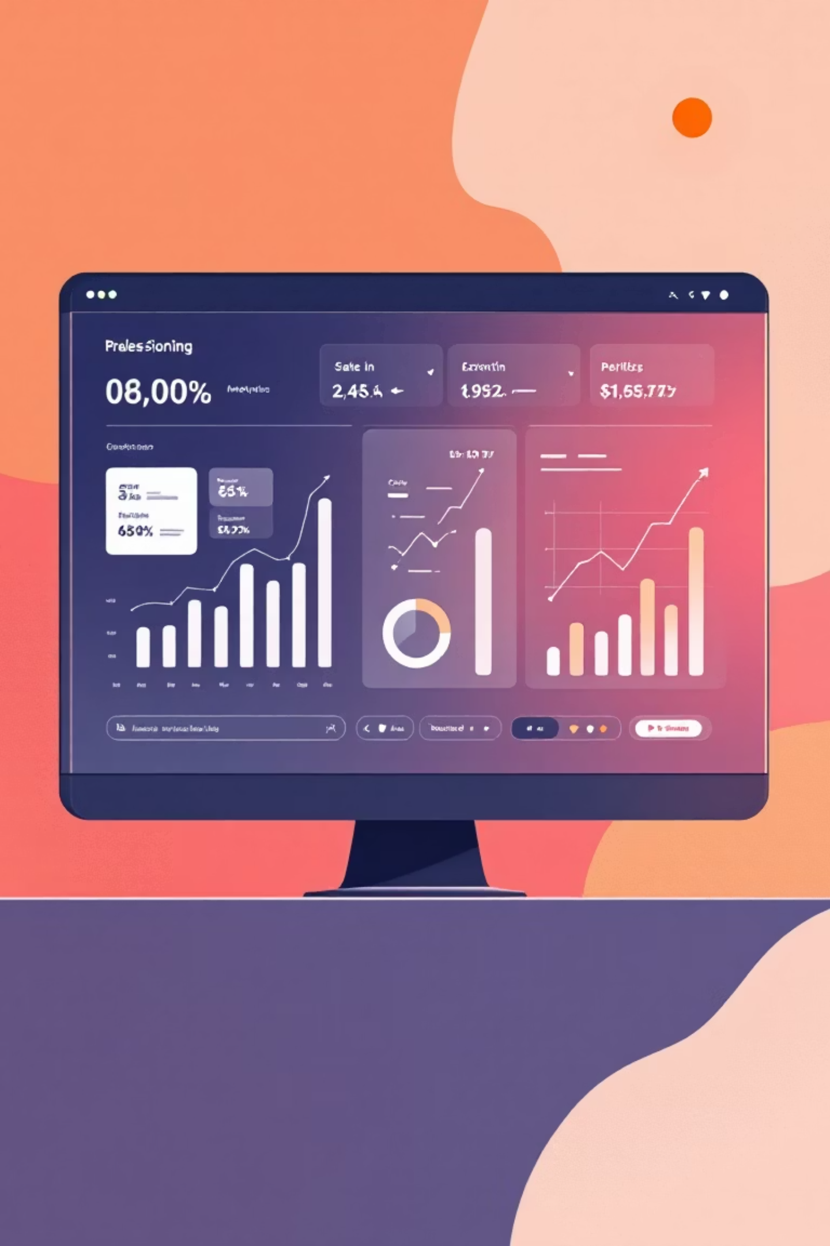
The G2H Experience
Meetings on Your Calendar
Honest Reporting
Your sales team starts each week with qualified conversations already scheduled, no more chasing cold leads.
Clear, transparent metrics that show real progress instead of vanity numbers that don't drive revenue.
Predictable Rhythm
Outbound becomes a steady, reliable engine supporting your revenue goals, not a random activity.

Slide 7



Who We're Built For
B2B Sales-Led Teams
Brand-Conscious Organizations
Strategic Partners
Companies with a sales-driven motion seeking consistency at the top of the funnel.
Leaders who want a partner bringing ideas and insights, not just activity reports.
Teams that value thoughtful outreach and reputation over high-volume spam tactics.

Slide 8

Ready to Transform Your Pipeline?
The best place to start is a short working session where we'll discuss your current pipeline, priority segments, and what you've already tried.
Let's explore whether G2H Solutions is the right fit for your team.
Get Started
Learn More

Slide 9

Let's Connect
Website
Email
www.g2hsolutions.com
sales@g2hsolutions.com
Location
Hyderabad, Telangana, India

